Slide 1
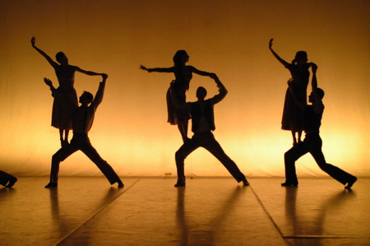
Physical Setting
Lesson Aims
I will be able to understand and describe aspects of physical setting
I will be able to answer an exam question relating to physical setting

Slide 2
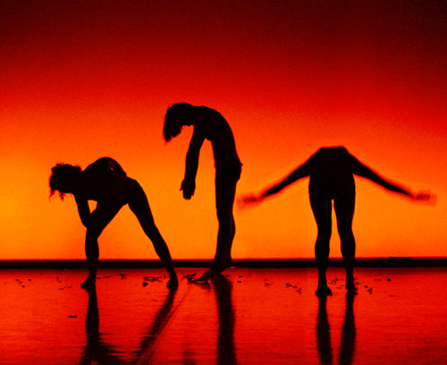
What is physical setting?
Physical setting simply means the dance environment.
Physical Setting includes set, lighting, props, performance space, features: colour, texture, decoration, level and shape.

Slide 3
Colour
How can it create mood?
Can you think of two different examples from Rosas?

Slide 4
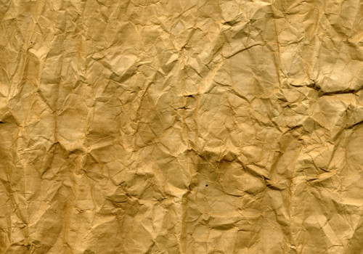
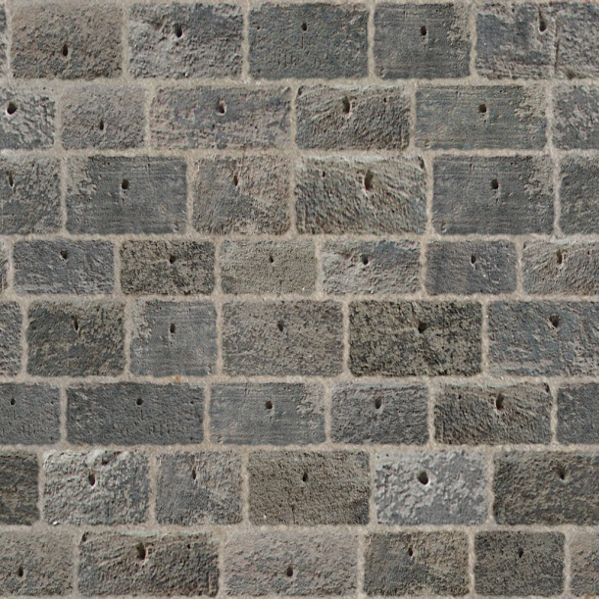
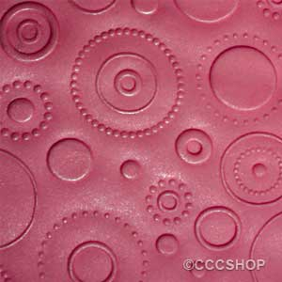
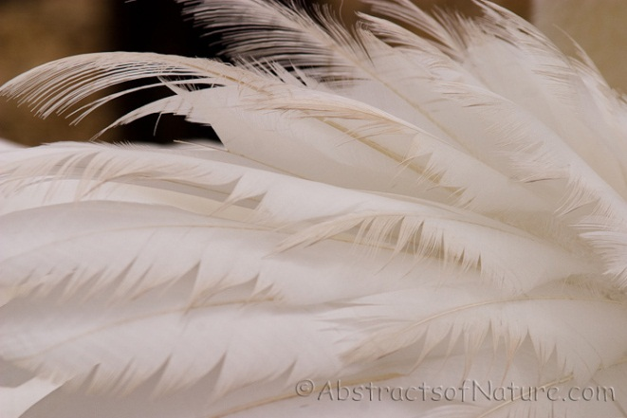
Texture
Creates a visual impact
Can you think of an example from Rosas?

Slide 5
Decoration
What is the purpose of decoration?
Can you think of an example from Rosas?

Slide 6
Shape
How does this help the audience to understand what is happening?
Example from Rosas?

Slide 7
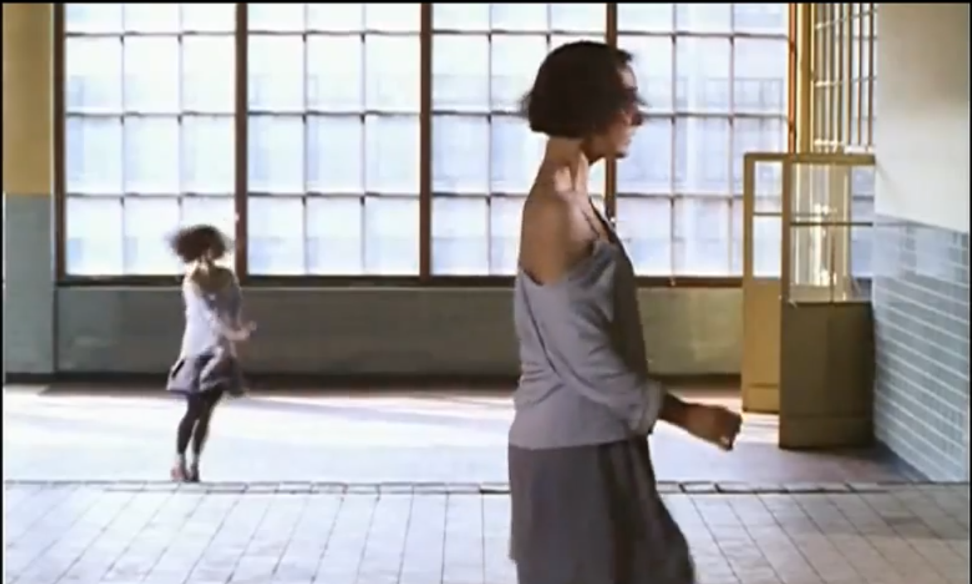
LEVELS
How can levels be used by the dancers in a performance?

Slide 8
Homework Exam Question
Compare the way the choreographer uses physical setting in Matthew Bourne's Nutcracker and Rosas Danst Rosas (8 Marks) Please remember to give specific examples and to write in full sentences! Also 8 Marks= 4 Marks (1 per new subject) and 4 marks for explaining each one with examples.

