Slide 1
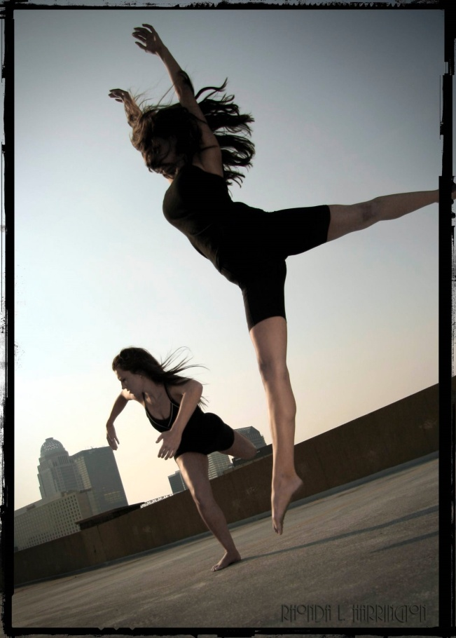
Technical and Expressive Skills
Today I will:
Be able to explain the difference between a technical and expressive skill.
Understand why these skills are essential for a dancer.
Be able to reflect on my own strengths and weaknesses.
St John’s skills: Information, reflective

Slide 2
Technical Skills
What is a technical skill? Discuss with a partner and write your ideas on a post it note.
Control
Posture
Balance
Alignment
Technical Skills
Mobility
Placement
Strength
Flexibility
Coordination

Slide 3
Expressive Skills
Musicality
A measure or degree to which a dancer is receptive and creative in their translation or rendering of music through movement.
Where should you be looking (at a body part, to a specific direction or communicating the idea).
Confident presentation of one’s body and energy to vividly communicate movement and meaning to an audience.
Focus
Projection

Slide 4
Expressive Skills Continued
Timing
To control the speed of an movement so that it happens at the proper moment.
d. The fitting of dance steps to the rhythm and/or melody of the music.
A dance that represents a particular character, especially in ballet.
Phrasing
Characterisation
http://www.backstage.com/bso/news-and-features-spotlights/spotlight-on-dance-1004111492.story

Slide 5
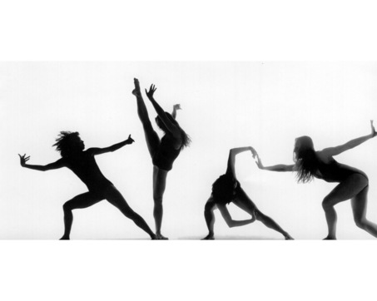
Plenary
Can you explain the following to a partner?
Balance
Alignment
Focus
Phrasing
Posture
Coordination
Projection

